Slide 1
Artificial Intelligence
Organizations are using artificial Intelligence technology to capture individual and collective knowledge and to codify and extend their knowledge base.

Slide 2
What Is Artificial Intelligence?
Artificial intelligence can be defined as an effort to develop computer-based systems (both hardware and software) that behave as humans.
Such systems would be able to
learn natural languages,
accomplish coordinated physical tasks (robotics),
utilize a perceptual apparatus that informs their physical behaviour and language (visual and oral perception systems), and
emulate human expertise and decision making (expert systems).

Slide 3
Such systems will also exhibit logic, reasoning, intuition, and the just plain common-sense qualities that we associate with human beings.
Another important element is intelligent machines, the physical hardware that performs those tasks.

Slide 4
Successful artificial intelligence systems are based on
human expertise,
knowledge and
selected reasoning patterns
but do not exhibit the intelligence of human beings.
Existing artificial intelligence systems do not come up with new and novel solutions to problems.
Existing systems extend the powers of experts but in no way substitute for them or capture much of their intelligence.
Briefly, existing systems lack the common sense and the generality of naturally intelligent machines like human beings.

Slide 5
Human intelligence is vastly complex and much broader than computer and information systems.
A key factor that distinguishes human beings from other animals is their ability to develop associations and use metaphors and analogies such as like and as.
Using metaphor and analogy, humans create new rules, apply old rules to new situations, and at times act intuitively and/or instinctively without rules.
Much of what we call common sense or generality in humans resides in their ability to create metaphor and analogy.

Slide 6
ANALOGIES
1. In is to out as Up is to Down
2. Go is to Green as Stop is to Red
3. Wheel is to Bike as Tire is to Car
4. Land is to Dirt as Ocean is to Water
5. Apple is to Tree as Flower is to Plant
6. Toe is to Foot as Finger is to Hand
7. Day is to Month as Minute is to Hour
8. Purple is to Grapes as Red is to Cherries
9. Word is to Sentence as Page is to Book
10. Small is to Large as Little is to Big
11. Three is to Triangle as Four is to Square
12. Rich is to Money as Well is to Health

Slide 7
Metaphor example | Metaphorical sense | Original sense
I'm not an angel, but I wouldn't behave like that. | exemplary person | a spiritual being believed to be a messenger of God
America is a melting pot. | place where different peoples, styles and cultures are mixed together | a container in which metals or other materials are melted and mixed
John is a real pig when he eats. | greedy person | a four-legged animal kept for meat (pork)
My father is a rock. | very strong or reliable person | a hard, mineral material made of stone
How could she marry a snake like that! | traitor | a long, limbless reptile (eg: cobra, python, viper)
The policeman let him off with a yellow card. | warning | (in soccer) a yellow card that the referee shows to players when cautioning them

Slide 8
Metaphor example | Original sense of the word (example)
The committee shot her ideas down one by one. | Anti-aircraft guns shoot down planes.
The private detective dug up enough evidence to convince the police to act. | Dogs like to bury bones and dig them up later.
He broke into her conversation. | Burglars break into buildings.
The new movie was very popular. People flocked to see it. | Birds flock together before they migrate.
His head was spinning with ideas. | Some computer hard drives spin at over 10,000 revolutions per minute.
Reading that book kindled my interest in politics. | You need to start with twigs and small branches when you kindle a camp fire.
Tim lost his job after a heated argument with his boss. | We have a heated swimming pool.
The new car's sexy design increased sales for the company. | Some women think that lipstick makes them look sexy.
He was dressed rather vulgarly in a loud checked suit. | I can't hear you because the radio is too loud.
It wasn't long before their relationship turned sour. | Sour food has an acid taste like lemon or vinegar.

Slide 9
simile | metaphor
Your eyes are like the sun. | You are my sunshine.
He eats like a pig. He lives like a pig. | He is a pig.

Slide 10
Why Business Is Interested In Artificial Intelligence
Although artificial intelligence applications are much more limited than human intelligence, they are of a great interest to business for the following reasons:
To preserve expertise that might be lost through retirement, resignation, or death of an accomplished expert.
To store information in an active form – to create an organisational knowledge base – that many employees can examine, much like electronic textbook or manual, so that others may learn rules of thumb not found in textbooks.

Slide 11
To create a mechanism that is not subject to human feelings such as fatigue and worry. This may be especially useful when jobs may be environmentally, physically, or mentally dangerous to humans. These systems may also be useful advisors in times of crisis.
To eliminate routine and unsatisfying jobs held by people.
To enhance the organisation’s knowledge base by suggesting solutions to specific problems that are too massive and complex to be analyzed by humans being in a short period of time.

Slide 12
Capturing Knowledge: Expert Systems
In limited areas of expertise, such as diagnosing a car’s ignition system or classifying biological specimens, the rules of thumb used by real world experts can be understood, codified, and placed in a machine.
Information systems that solve problems by capturing knowledge for a specific and limited domain or human expertise are called expert systems.
An expert system can assist decision making by asking relevant questions and explaining the reasons for adopting certain actions.

Slide 13
Expert systems lack the breadth of knowledge and understanding of fundamental principles of human expert.
They are quite narrow, shallow, and brittle. They typically perform very limited tasks that can be performed by professionals in a few minutes or hours.
Problems that cannot be solved by human experts in the same period of time are far too difficult for expert systems.
But by capturing human expertise in limited areas, expert systems can provide benefits, helping organizations make higher-quality decisions with fewer people.

Slide 14
How expert systems work
Human knowledge must be modelled or represented in a way that a computer can deal with it. The model of human knowledge used by systems is called the knowledge base.
Three ways have been devised to represent human knowledge and expertise:
1) rules 2) semantic nets, and 3) frames
A standard programming construct is the if-then construct, in which a condition is evaluated. If a condition is true, an action is taken. For instance,
IF INCOME > ₵45,000 (condition)
THEN PRINT NAME AND ADDRESS (action)

Slide 15
A series of rules can be a knowledge-base.
Virtually all traditional computer programs contain IF-THEN statements.
The difference between a traditional program and a rule-based expert system program is one of degree and magnitude.
Moreover, in an AI program the rules tend to be interconnected and nested and to a far larger degree than traditional programs.
Hence the complexity of the rules in a rule- based expert system is considerable.

Slide 16
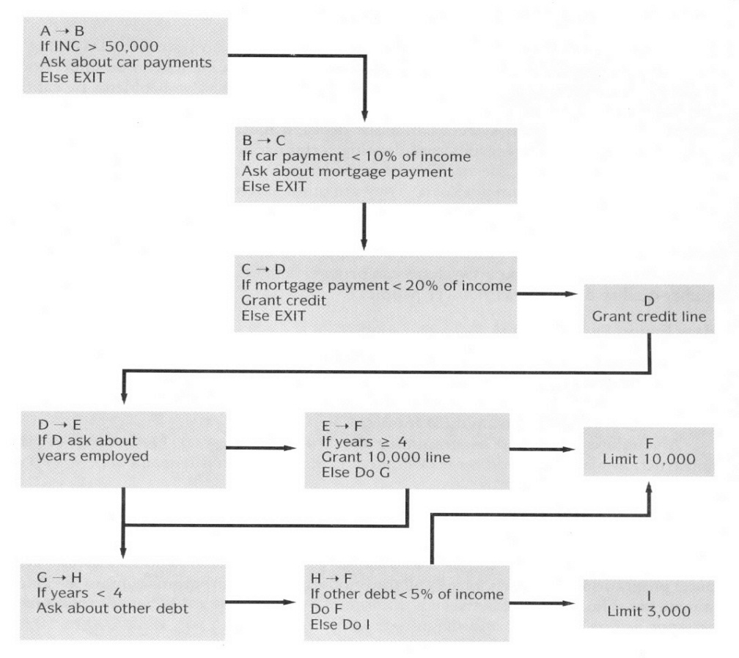

Slide 17
But not all knowledge can be represented in that way, e.g. knowledge in an encyclopaedia Britannica.
Because the rule base is too large, and not all the knowledge in the encyclopaedia can be represented in the form of IF-THEN rules.
In general expert systems can be efficiently used only in those situations where the domain of the knowledge is highly restricted (such as in granting credit) and involves no more than a few thousand rules.

Slide 18
Semantic nets can be used to represent knowledge when the knowledge-base is composed of easily identified chunks or objects of interrelated characteristics.
Semantic nets can be more efficient than rules. They use the property of inheritance to organize and classify objects.
A condition such as “IS A” ties objects together - “IS A” is a pointer to all objects of a specific class.

Slide 19
For instance the next figure shows a semantic net that is used to classify kinds of automobiles. All specific automobiles in the lower part of the diagram inherits characteristics of the general categories of the automobiles above them. Insurance companies can use such a semantic net to classify cars into rating classes.

Slide 20
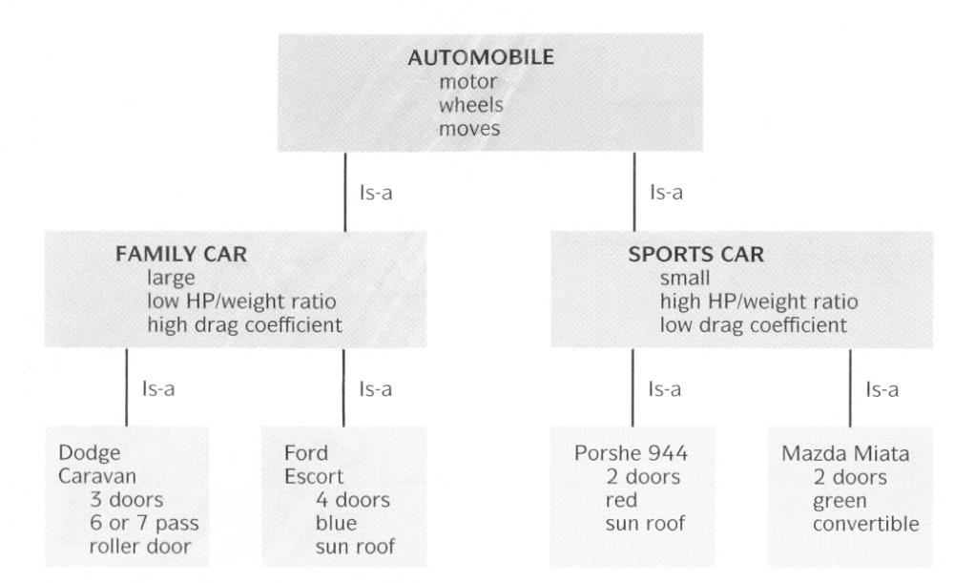

Slide 21
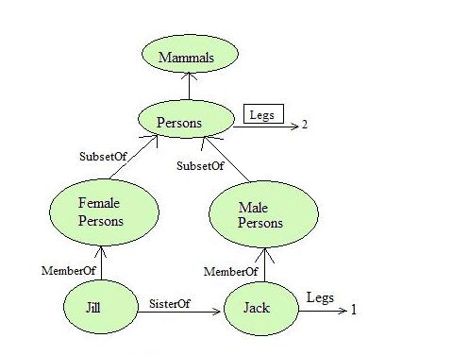

Slide 22
So semantic network allows us to perform inheritance reasoning.
Semantic nets allow multiple inheritance. So an object can belong to more than one category and a category can be a subset of more than one category.
Semantic network also allows a common form of inference known as inverse links.

Slide 23
Knowledge frames also organise knowledge into chunks, but the relationships are based on shared characteristics rather than a hierarchy.
The approach is grounded in the belief that humans use frames, or concepts, to make rapid sense out of perceptions.

Slide 24
For instance, when a person is told, “look for a tank and shot if you see one,” experts believe that the humans invoke a concept, or frame, of what a tank should look like.
Anything that does not fit this concept of a tank is ignored.
In a similar fashion, AI researchers can organise a vast array of information into frames.
The computer is then instructed to search the database of frames and lists connection to frames of interest. The user can follow the various pathways pointed to by the systems.

Slide 25
The next figure shows a part of a knowledge base organized by frames.
A “CAR” is defined by characteristics or slots in a frame as a vehicle, with four wheels, a gas or diesel motor, and an action like rolling or moving.
The frame could be related to just about any other object in the database that shares any of these characteristics, such as the tank frame.

Slide 26
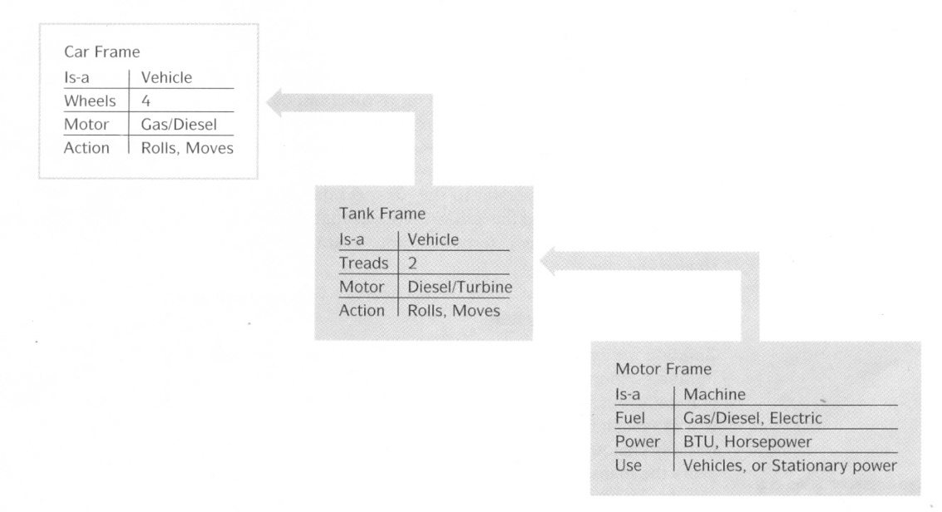

Slide 27
For example, when a furniture salesman says “I have a nice chair that I want you to see”, the word ‘chair’ would immediately trigger in our minds a series of expectations.
We would probably expect to see an object with four legs, a seat, a back and possibly (but not necessarily) two arms.
We would expect it to have a particular size and serves a place to sit.

Slide 28
In an AI system, a frame CHAIR might include knowledge organized as shown below:
Frame : CHAIR
Parts : seat, back, legs, arms
Number of legs : 4
Number of arms: 0 or 2
Default : 0

Slide 29
Frames therefore represent an object as a group of attributes.
Each attributes in a particular frame is stored in a separate slot.

Slide 30
The AI shell is a programming environment of an expert system.
In the early years of expert systems, computer scientists used specialized programming languages such as Lisp or Prolog that could process lists of rules efficiently.
Today, a growing number of expert systems use AI shells that are user-friendly development environments.
AI shells can quickly generate user-interface screens, capture the knowledge base and manage the strategies for searching the rule base.

Slide 31
The strategy used to search through the rule base is called the inference engine.
Two strategies are commonly used: forward chaining and backward chaining.
In forward chaining, the inference engine begins with the information entered by the user and searches the rule base to arrive at a conclusion.
The strategy is to fire, or carry out, the action of the rule when a condition is true.

Slide 32
In backward chaining, the strategy for searching the rule base starts with a hypothesis and proceeds by asking the user questions about selected facts until the hypothesis is either confirmed or disproved.

Slide 33
Building an expert system
Similar to building other information systems, although building expert systems is an iterative process with each phase requiring several interactions before a full system is developed.
Typically the environment in which an expert system operates is continually changing so that the expert system must also continually change.
Some expert systems, especially large ones, are so complex that in a few years the maintenance costs will equal the development costs.

Slide 34
An AI development team is composed of one or more experts, who have a thorough command over the knowledge-base, and one or more knowledge engineers, who can translate the knowledge (as described by the expert) into a set of rules, frames or semantic nets.
A knowledge engineer is similar to a traditional systems analyst but has special expertise in eliciting information and expertise from other professionals.

Slide 35
Problems with expert systems
Although experts systems lack the robust and general intelligence of human beings, they can provide benefits to organizations if their limitations are well understood.
Only certain classes of problems can be solved using expert systems. Virtually all successful expert systems deal with problems of classifications in which there are relatively few alternative outcomes and in which these possible outcomes are well-known in advance.
Many expert systems require large, lengthy, and expensive development efforts.
Hiring or training more experts may be less expensive than building an expert system.

Slide 36
The knowledge base of expert systems is fragile and brittle; they cannot learn or change over time.
In fast moving fields such as medicine or the computer sciences, keeping the knowledge base up to date is a critical problem.

Slide 37
Expert systems can only represent limited forms of knowledge. IF-THEN knowledge exists primarily in books.
No expert system, for instance, can write a text book on information systems or engage in other creative activities not explicitly foreseen by system designers.
Many experts cannot express their knowledge using an IF-THEN format.
Expert systems cannot yet replicate knowledge that is intuitive, based on analogy and a sense of things.

Slide 38
Contrary to early promises, expert systems do best in automating lower-level clerical functions.
They can provide electronic check lists for lower-level employees in service bureaucracies such as banking, insurance, sales, and welfare agencies.
The applicability of expert systems to managerial problems is very limited. Managerial problems generally involve drawing facts and interpretations of the facts with another, and do not involve analysis or simple classification.
Expert systems based on the prior knowledge of a few known alternatives are unsuitable to the problems managers face on a daily basis.

